Slide 1
Data Warehousing
Prepared by:Mohamemd Sayeeduddin

Slide 2
What is data warehouse
A data warehouse (DW) is a repository that stores relational data that is organized, cleansed, and standardized for enterprise use. A data warehouse is organized by subject-oriented databases and is non-volatile in direct support of decision support system (DSS) functionality. In so doing, a data warehouse includes strategically selected data that is important to an enterprise for historical tracking, reporting, and analysis.
A data warehouse has the following characteristics:
Subject-oriented: data is theme- or object-based (i.e., customer, product, sales, etc.)
Integrated: disparate data is combined and normalized from source systems
Time-variant: data is organized by various time intervals for historical reporting and preservation (i.e., week, month, quarter, year)
Non-volatile: data is never changed or deleted; data is read-only and refreshed at well-defined time intervals
Summarized: data is often aggregated for optimization of reporting

Slide 3
Data Warehousing Architectures
Data warehouses can be architected using varying approaches. There are two primary approaches: the dimensional approach (popularized by Ralph Kimball) and the normalized approach (popularized by Bill Inmon).
Dimensional Approach
Kimball’s approach depicts a data warehouse via a dimensional model (star schema or snowflake). The dimensional approach uses a “bottom-up” design, in which individual data marts are created at the departmental or organizational level (i.e., sales, human resources, finance, etc.) and built up to an enterprise data warehouse (EDW). Today, Kimball’s approach is more popular because business users can quickly gain usefulness from it.

Slide 4
Normalized Approach
Inmon, on the other hand, utilized a “top-down” approach to normalize a data warehouse. The normalized enterprise data model creates a central repository or enterprise data warehouse. Dimensional data marts for specific departments or organizational units can be created from the master enterprise data warehouse.

Slide 5
Extract, Transform, Load (ETL)
Extract, transform, load (ETL) is the process of data integration from source operational or transactional systems to combine disparate data to a single format in a central repository. Source data is extracted from transactional systems; transformed for normalization, formatting, and error correction; and loaded to the data warehouse for analytics and reporting

Slide 6
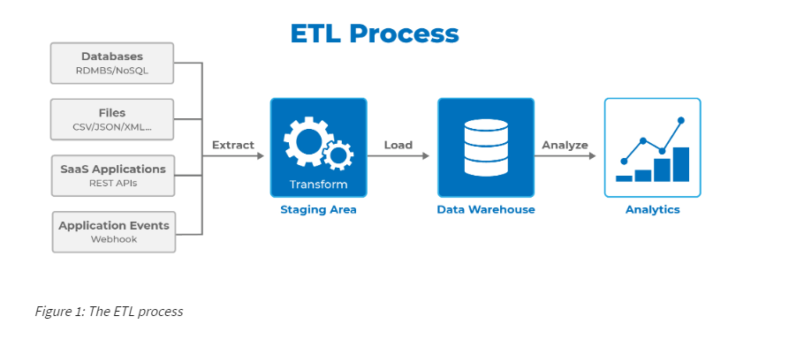

Slide 7
Data Mart
A data mart is a subset of an enterprise data warehouse and is often referred to as a “departmental data warehouse.” A data mart contains the same type of information that exists in an enterprise data warehouse, but the data is organized and optimized for a specific department or organizational unit. The diagram in Figure 2 provides a high-level architecture of data warehousing and shows how data marts fit into this architecture.

Slide 8
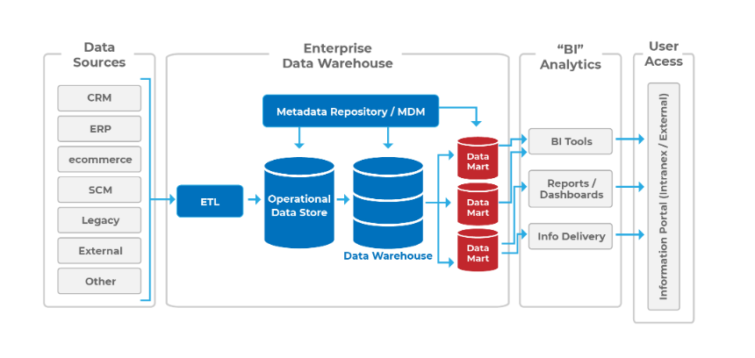
Enterprise Data warehouse

Slide 9
Operational Data Stores
An operational data store (ODS) utilizes snapshots of operational or transactional systems’ data to provide operational business reporting. ODS differs from a data warehouse because the data is accessed directly from the transactional system databases, and the operational data store is able to write data back to the source systems. A primary purpose of an operational data store is to deal with the complexities of maintaining up-to-date data in the data warehouse. Thus, the ODS can be seen as a less expensive approach to real-time data reporting.

Slide 10
Data Warehousing in the Cloud
Data warehouses traditionally exist inside an organization’s local infrastructure (on-premises), where the responsibility for configuration and maintenance lies solely on information technology (IT) staff at the organization. Data warehousing in the cloud shifts much of the responsibility for hardware, networking, security, and maintenance to a third party, which allows the organization to focus more on business goals and objectives. This approach also allows users (who are often remote or mobile) a higher, more consistent level of data warehouse availability.

Slide 11
Star Schema
A star schema is a model that depicts data in a shape similar to that of a star. A fact table exists in the center of the star and contains primary and foreign keys to associated dimension tables, as well as aggregated data from the operational or transactional systems. The dimension tables describe the data and are included based on business needs. A star schema is not normalized and provides simple modeling without the need for complex joins.

Slide 12
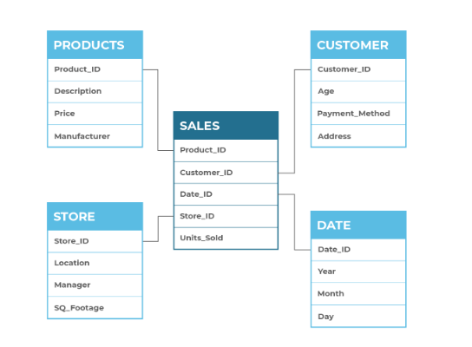
Star Schema

Slide 13
Snowflake Schema
The snowflake schema design contains the same data that would exist in a star schema, and the fact table and dimension tables look the same. The main difference between the two is that the snowflake schema is normalized. The process of normalizing the design is referred to as snowflaking. The snowflake schema also requires less work to add more data to existing dimensions and requires less storage due to the lack of redundancy in the normalization process. Figure 2 displays an example of a snowflake schema.

Slide 14
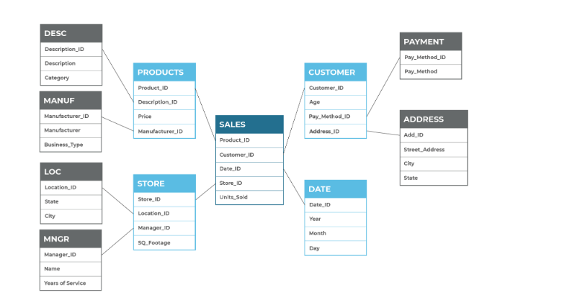

Slide 15
Quiz
Question 1
A ____________ is a repository that stores relational data that is organized, cleansed, and standardized for enterprise use.
Database
Data Warehouse
Database Management System

Slide 16
Answer
Data ware house:
Correct! A data warehouse is organized by subject-oriented databases and is non-volatile in direct support of Decision Support System (DSS) functionality.

Slide 17
Quiz 2
Which data warehousing architecture approach utilizes a bottom-up design?
Dimensional
Denormalized
Normalized

Slide 18
Answer
Dimensional
Correct
Correct! Kimball’s approach uses a “bottom-up” design, in which individual data marts are created at the department or organizational unit level (i.e., Sales, Human Resources, Finance, etc.) and built up to an enterprise data warehouse.

